Slide 1
Home page overview
WDSPdb 3.0 http://www.wdspdb.com/wdspdb3/

Slide 2
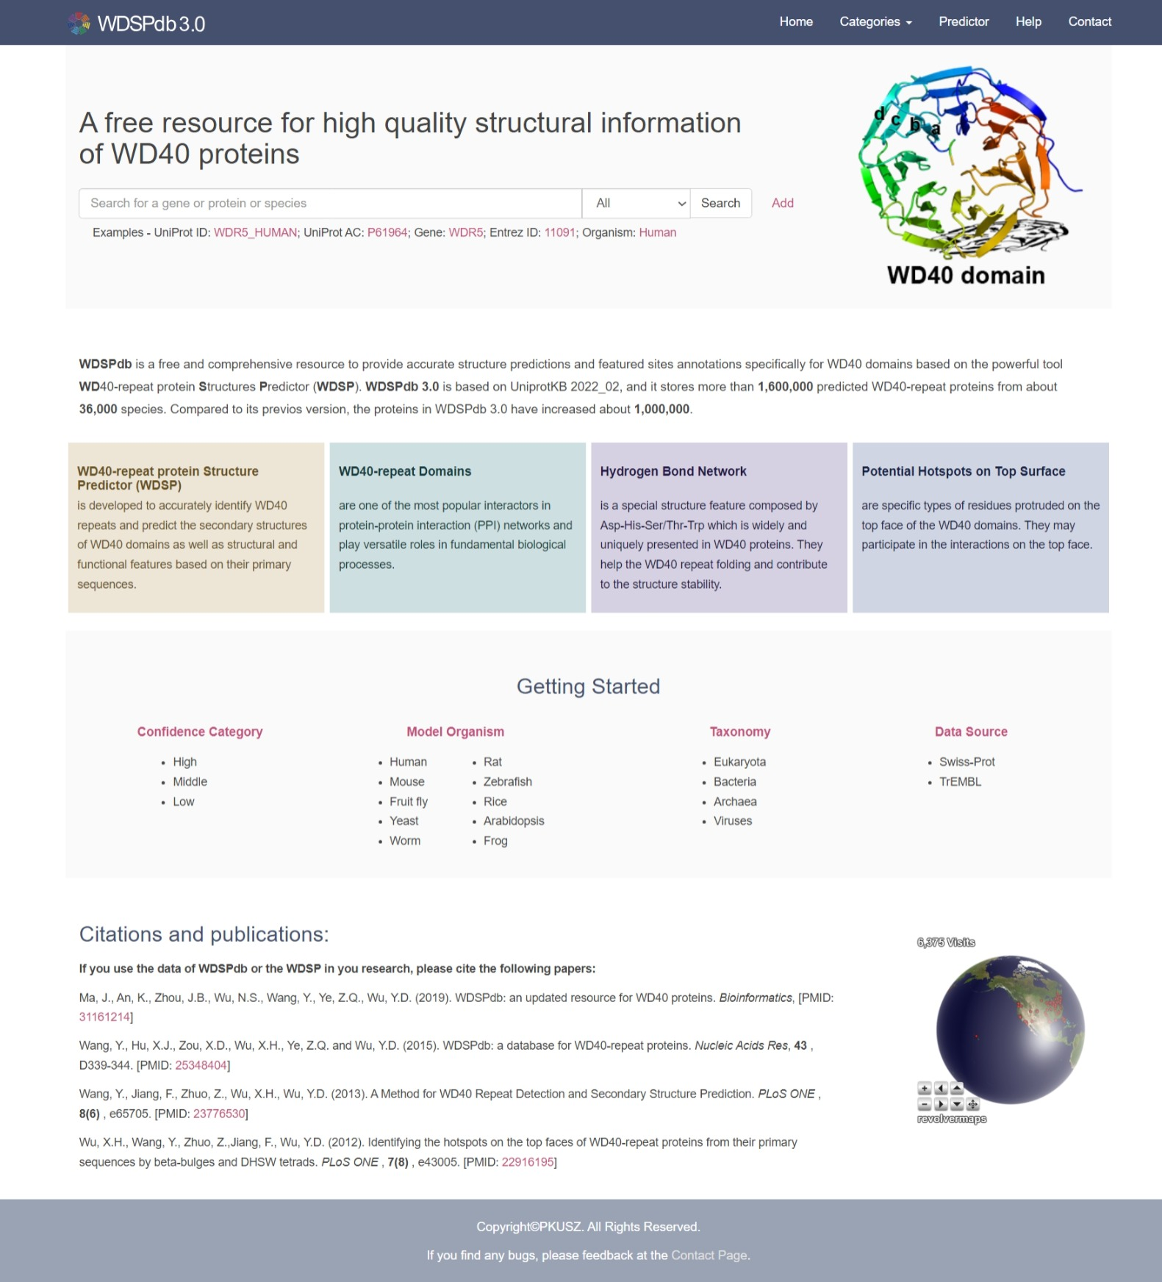
Home page overview
Navigation bar
Search box
At a glance
Getting started
Citations and publications
Visiting records

Slide 3
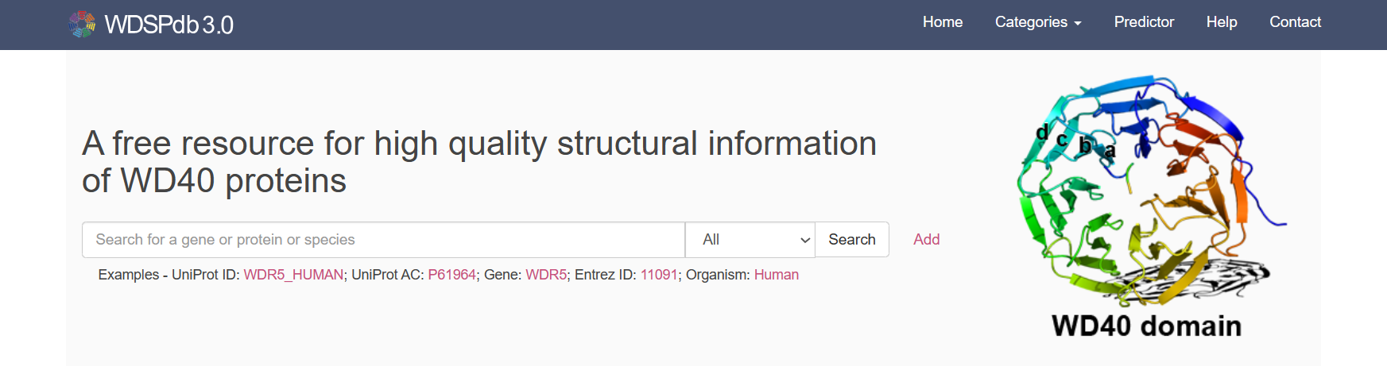
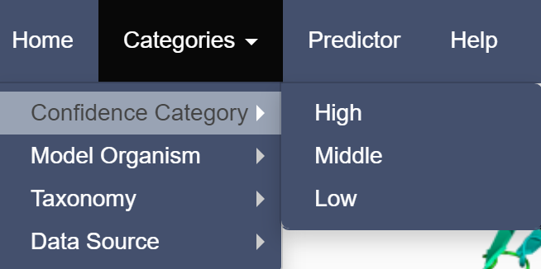
Home page: Navigation bar
Jump to WDSP predictor
Jump to home page
Jump to contact page
Jump to the help page
Directed to different category

Slide 4
Home page: Search box
Search box
Examples
Specify the type of user's keyword
Add multiple search boxes for advanced searching

Slide 5
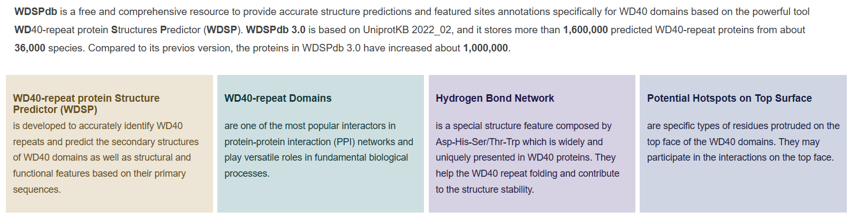
Home page: A glance of associated knowledge

Slide 6
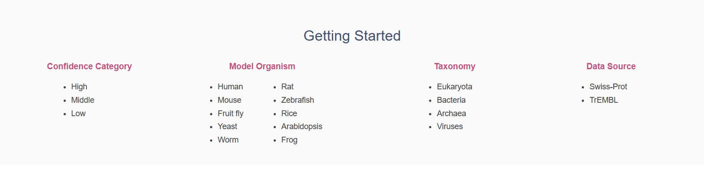
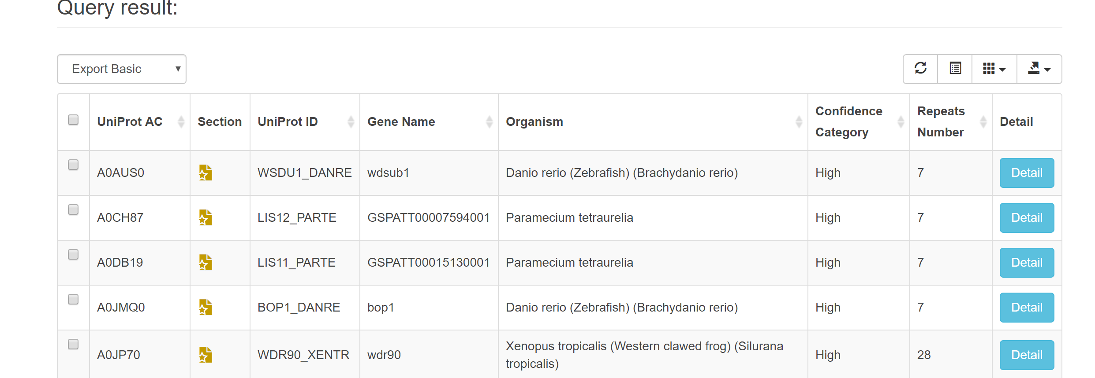
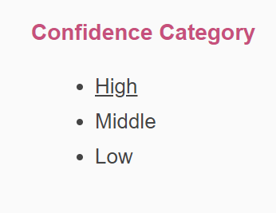

Home page: Getting started
Users can browse the protein list of different categories from the “Getting Started” portal
For example:
Jump to the protein list with “High” confidence category

Slide 7
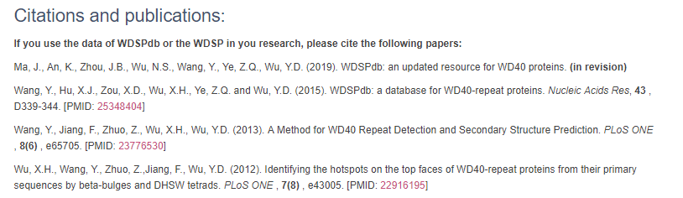
Home page: Citations and publications
WDSPdb 2.0
WDSPdb 1.0
WDSP prediction tool
Interaction hotspots prediction

Slide 8
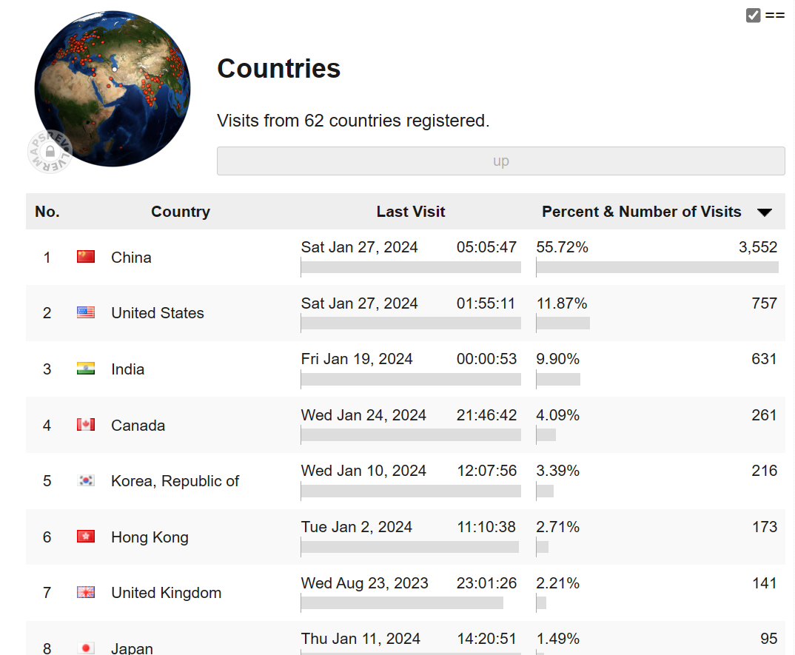
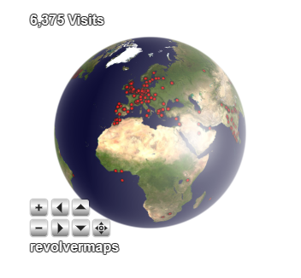
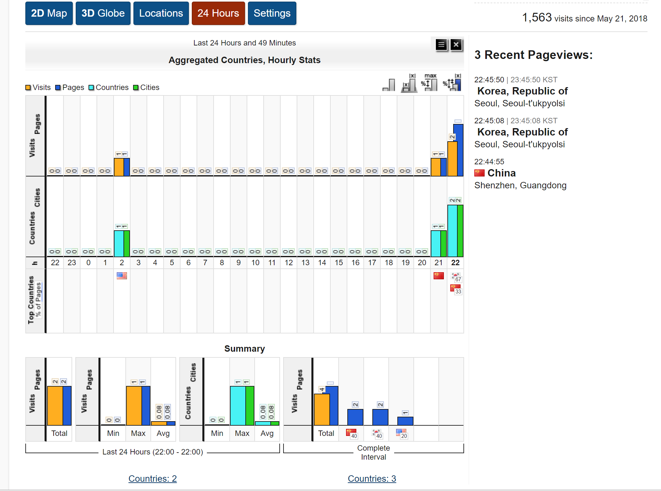
Home page: Visiting records
The details of the visiting records
Tellurion action bar

