Slide 1
How to download data in a batch?
WDSPdb 3.0 http://www.wdspdb.com/wdspdb3/

Slide 2
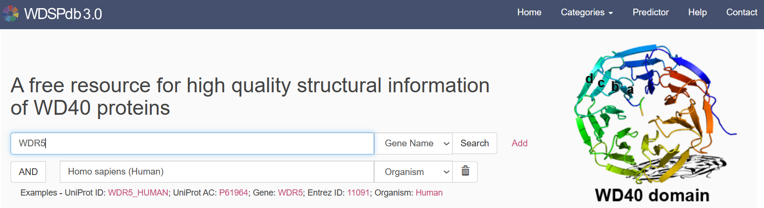
First step: Search the keyword to get the protein list you wanted
Use the search box at the home page
For example:
Search the “Gene Name” of “WDR5” and the “Organism” of “Homo sapiens (Human)”

Slide 3
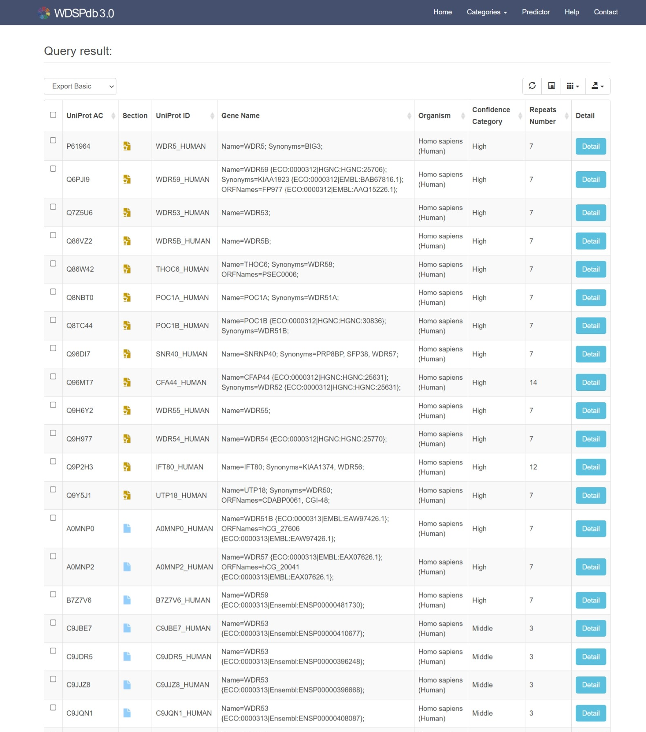
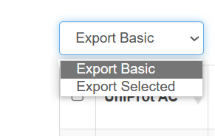
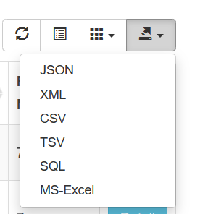
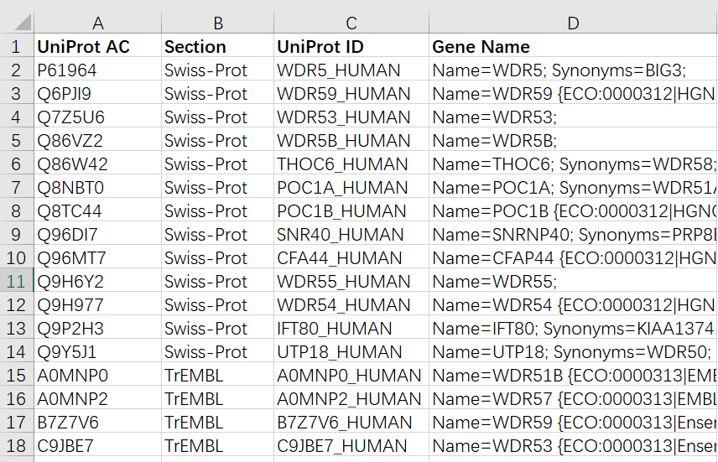

Second step: Export the protein list
Check the proteins you wanted in search result
Export the protein list in different format and get the UniProt AC you wanted
Notes:
重新截图，用上前面的勾选框，再导出列表。列表中的section要写完整。

Slide 4
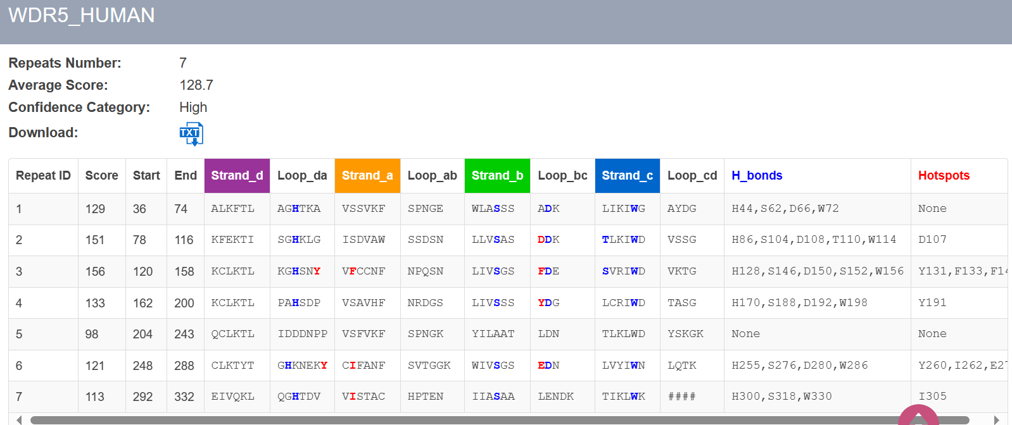
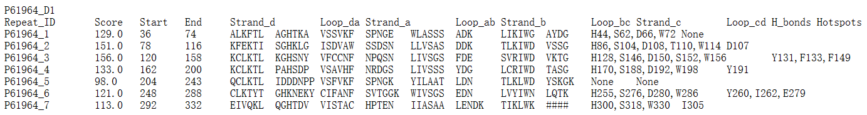
Third step: Construct specific URL
Jump to the protein detail page
The URL format:
http://www.wdspdb.com/wdspdb3/detail/+UniProt AC
For example: WDR5_HUMAN(P61964)
http://www.wdspdb.com/wdspdb3/detail/P61964
OR
Jump to the plain text of WDSP result
The URL format:
http://www.wdspdb.com/wdspdb3/detail/+UniProt AC+”.txt”
For example: WDR5_HUMAN(P61964)
http://www.wdspdb.com/wdspdb3/detail/P61964.txt

Slide 5
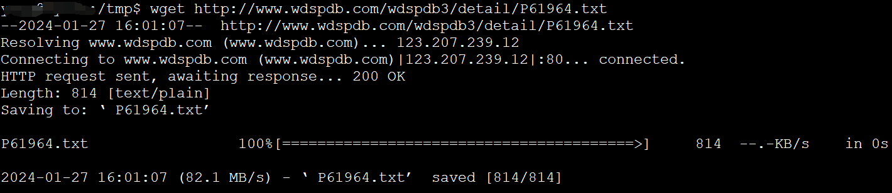
Fourth step: Download using the REST API
Input specific URLs to browsers and download WDSP result through the REST API
Programmatically download WDSP results through the REST API in a batch
For example:
Using the “wget” tool to download WDSP result
Note: The limitation of the batch download is two sequences per second.

