Slide 1
How to use WDSP predictor?
WDSPdb 3.0 http://www.wdspdb.com/wdspdb3/

Slide 2
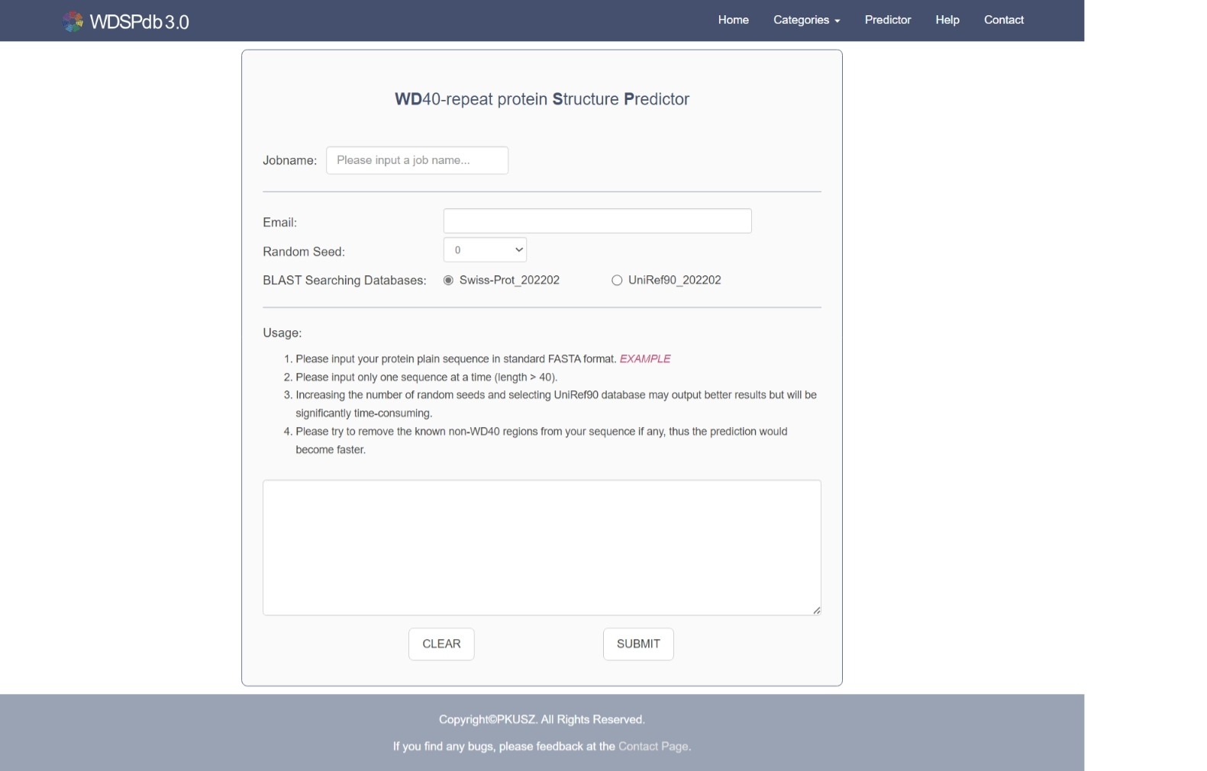
The WDSP predictor
The job name
Entrance of WDSP predictor in navigation bar
Email address to receive prediction result
Random number seeds for running the predictor
Usage of the WDSP predictor
BLAST searching database
Inputting sequences for predicting
Submit button

Slide 3
The pipeline of using WDSP predictor
Input the job name. The length of name should be shorter than 20.
Leave an email address for receiving the prediction results. The server will check if you have entered a valid address.
Choose the random seed(s) for WDSP running. And the predictor will output the result having the highest score.
Select the sequence database for running PSIBLAST
Input the protein sequences in standard FASTA format. The unnatural amino acids are not allowed. Only one sequence will be submitted to WDSP. If two or more sequences are inputted, only the first one will be run. The length must be >= 40 residues.
Click the button “SUBMIT” to submit the job

Slide 4
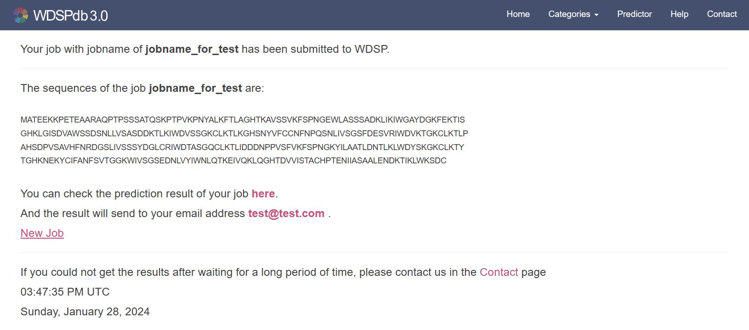
The link to the job result
After the job submitted, the predictor will jump to the page including the result information
The job name submitted
The input sequence
The link to the result page
The email address for receiving to the link of prediction result

Slide 5
The link to the job result
The WDSP predictor will take some time to run the job.
Before the job complete, the result page will be shown as following.

Slide 6
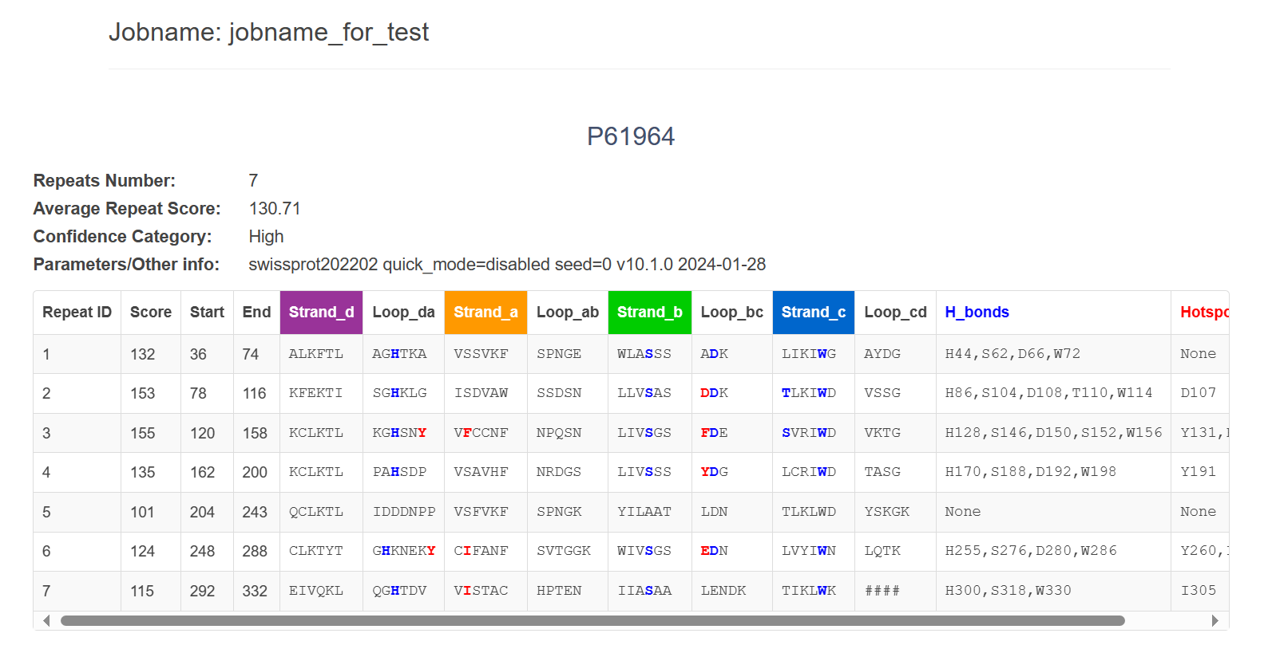
The predicted result
When the job is complete, the result page will present as following.
The job name submitted
The sequence identifier
WDSP prediction result
Note: for the he interpretation of the prediction result please refer to the guide of “Protein detail page” and the Help page.

Slide 7
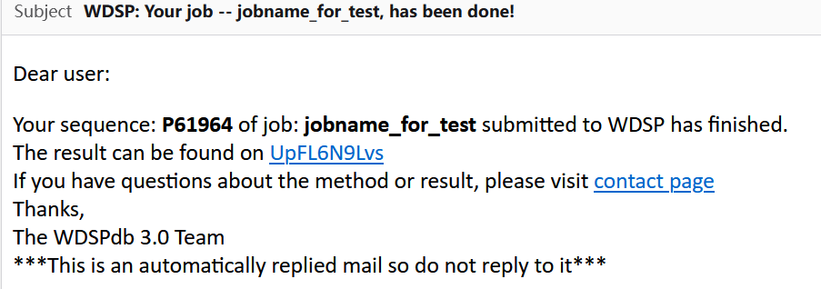
The email from WDSP predictor
When your task is complete, the WDSP predictor also send an email to the address you inputted
The contents of the email are as follows
The sequence identifier
The job name submitted
The link to result page.
> “UpFL6N9Lvs” is the unique Job_ID generated by WDSP predictor for each job.
The result link composed as follow: http://www.wdspdb.com/wdspdb3/output/kiYSWy

