Slide 1
How to use the search box?
WDSPdb 3.0 http://www.wdspdb.com/wdspdb3/

Slide 2
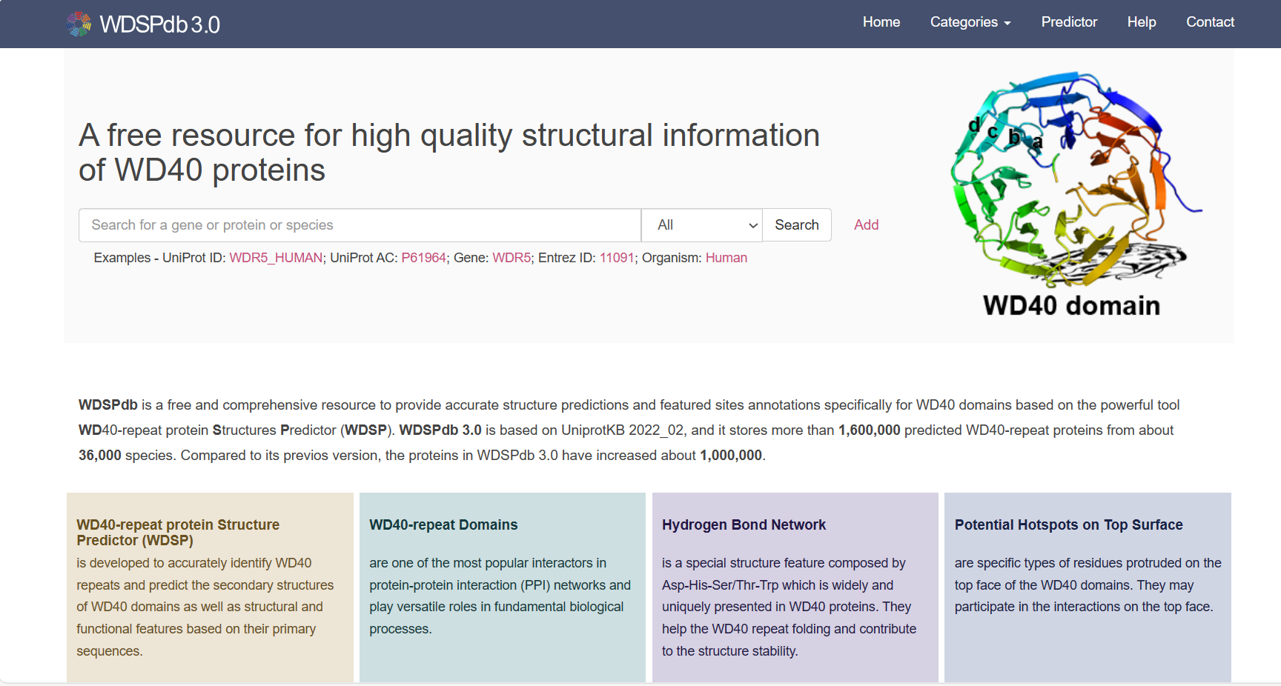
The search box located at the home page
Search box

Slide 3
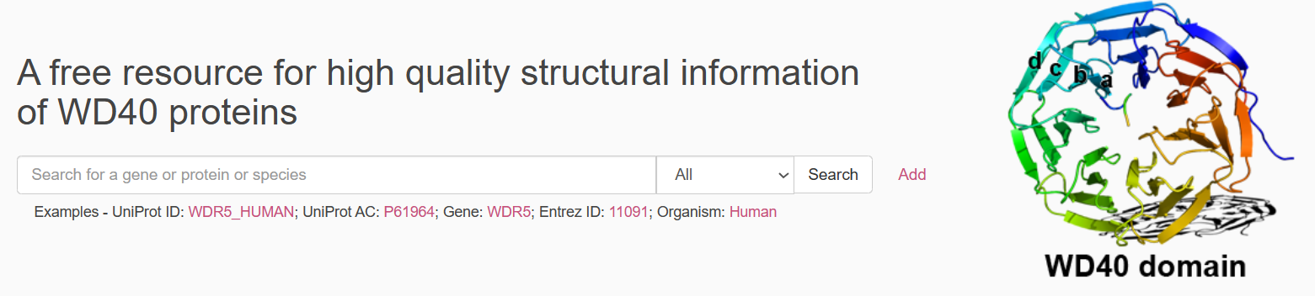
Introduction of search box
Search box
Examples
Specify the type of user's keyword
Add multiple search boxes for advanced searching

Slide 4
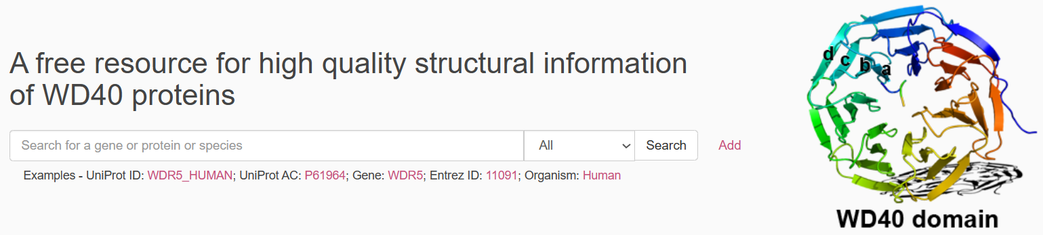
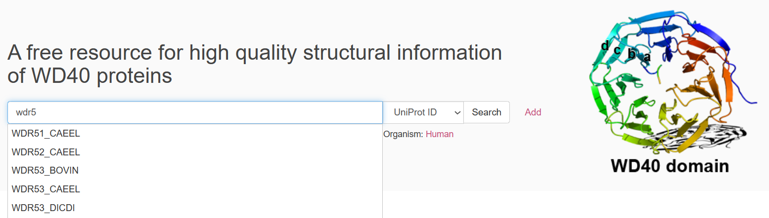
Introduction of search box
No pop-up prompts when specifying “All”
Pop-up prompts when specifying the type of the keyword
Notes:
截图多个，（1）选择all时没有提示，（2）选择其它时有提示

Slide 5
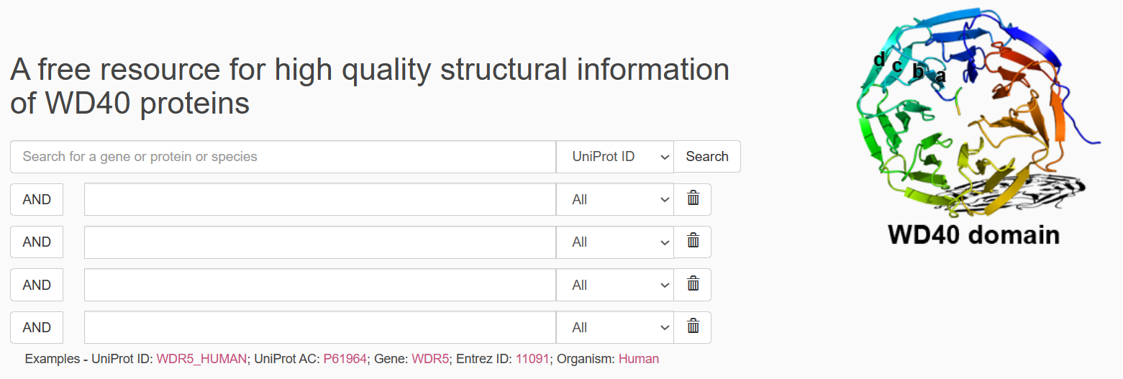
Introduction of search box
By adding multiple search boxes, you can specify multiple keywords for searching.
The maximum number of search boxes is 5.
When the number of search boxes reaches 5, the button is no longer available
Search box deleting button
The logical relationships among multiple keywords are “AND”
Specify different keyword types

Slide 6
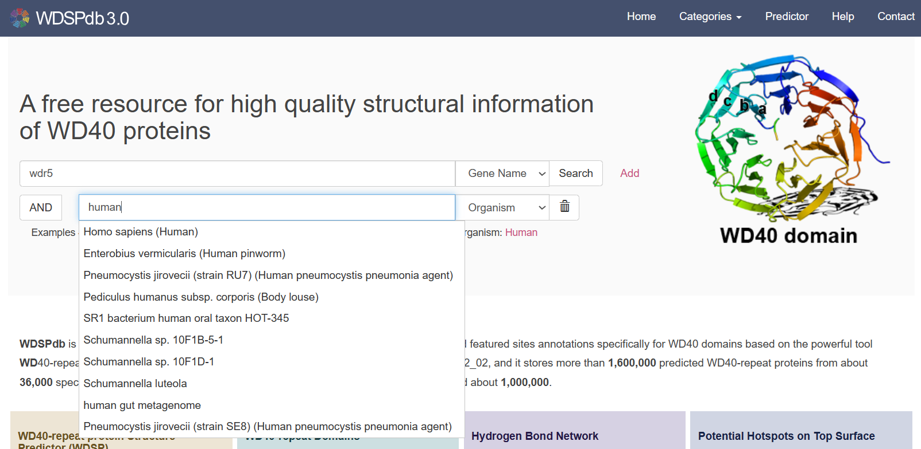
Example of using search box
For example, if you want to search for the Gene Name “wdr5” within the human species as keywords.
Input the keyword “wdr5”
Specify the “Gene Name” as the keyword type
Click “Add” button to add search box
Click “Search” button to perform the search
Input “human” into the search box, and select “Homo sapiens (Human)” from the pop-up prompts.
Specify the “Organism” as the keyword type

Slide 7
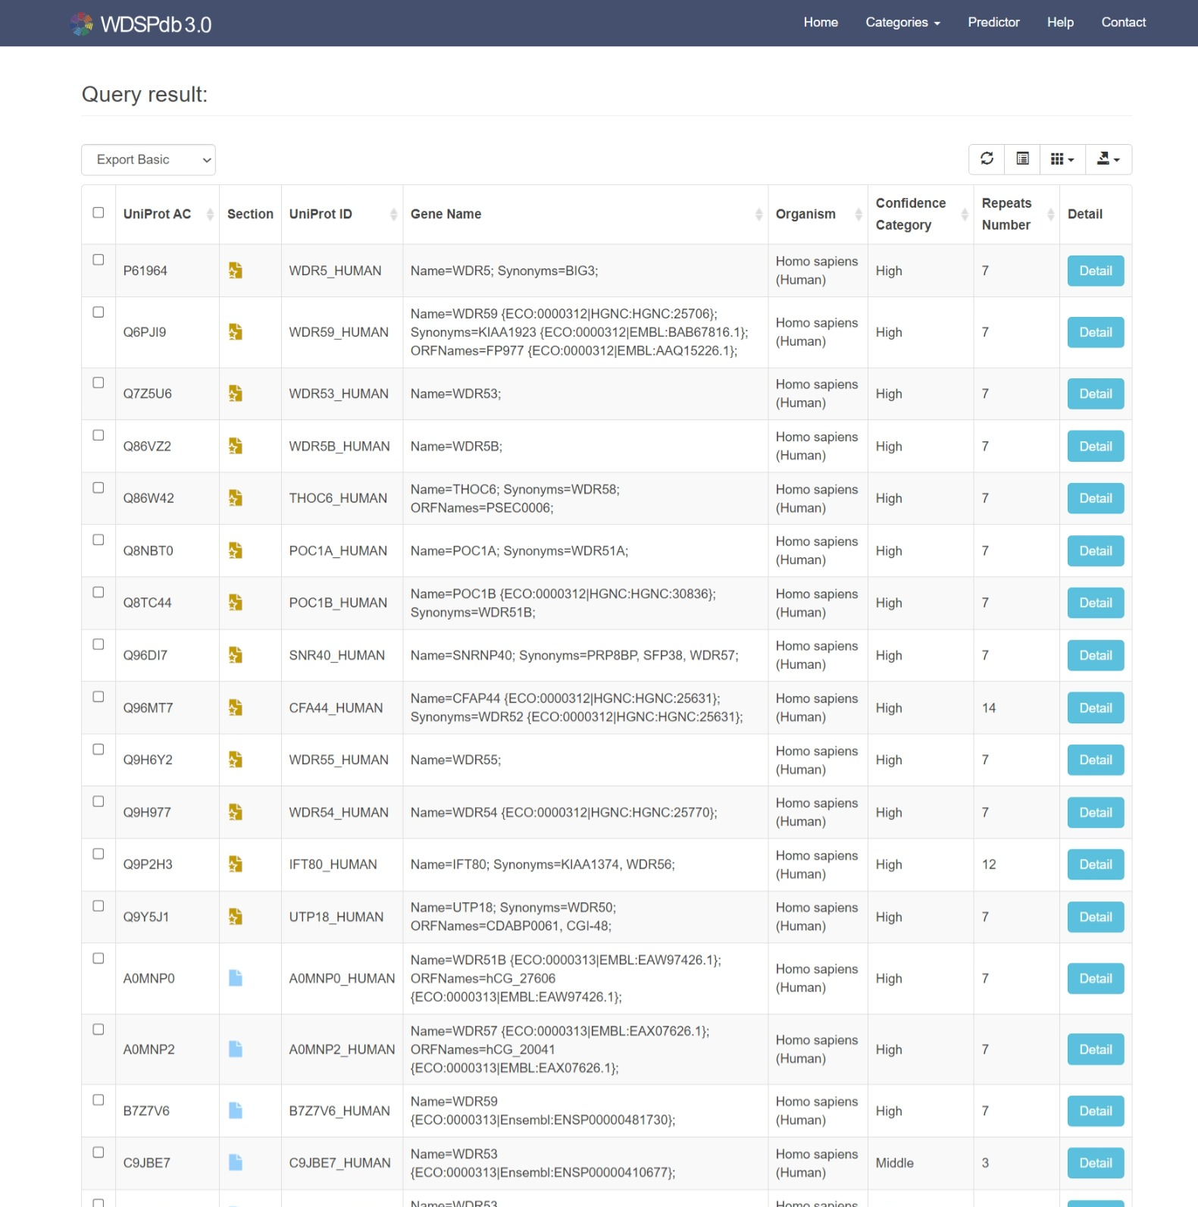
Search result
Action bar of the result table
The link to the protein detail page
Section tag:
from UniProt/Swiss-Prot
from UniProt/TrEMBL
Notes:
截图请截包含Swiss和Trembl的，该图只有Swiss呀

Slide 8
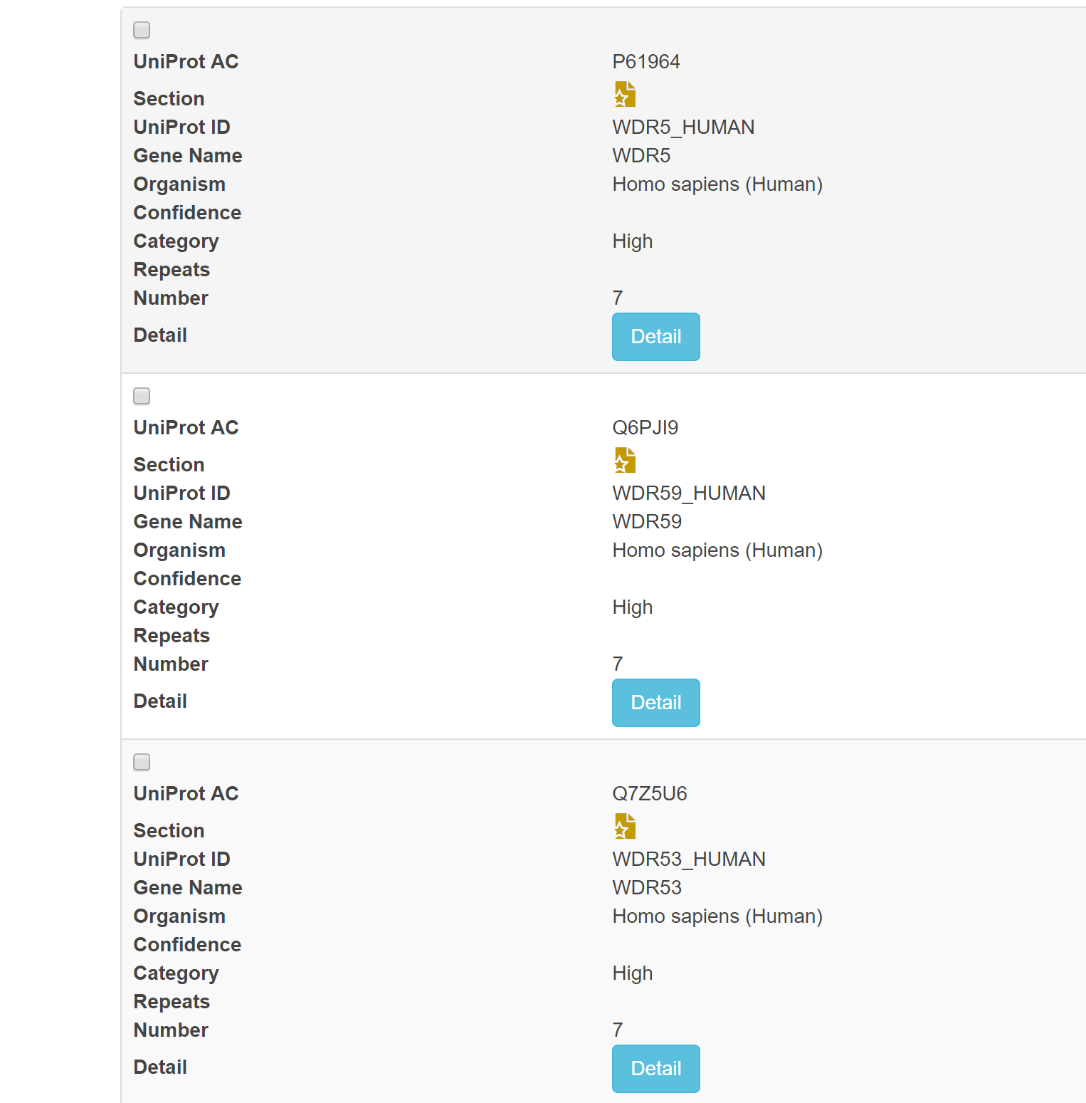
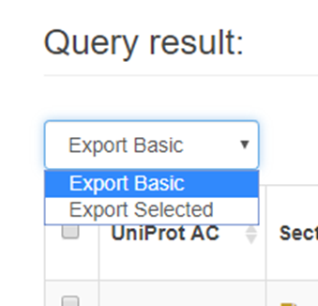
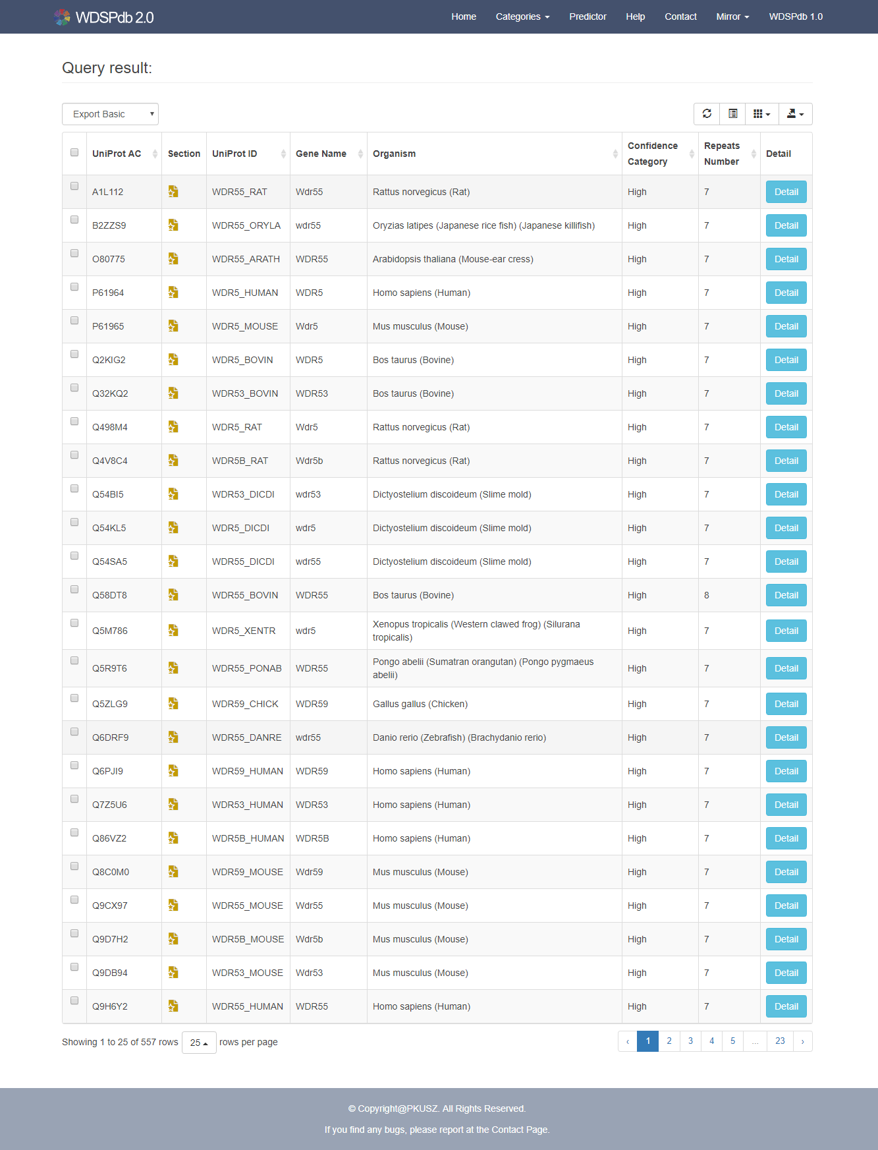
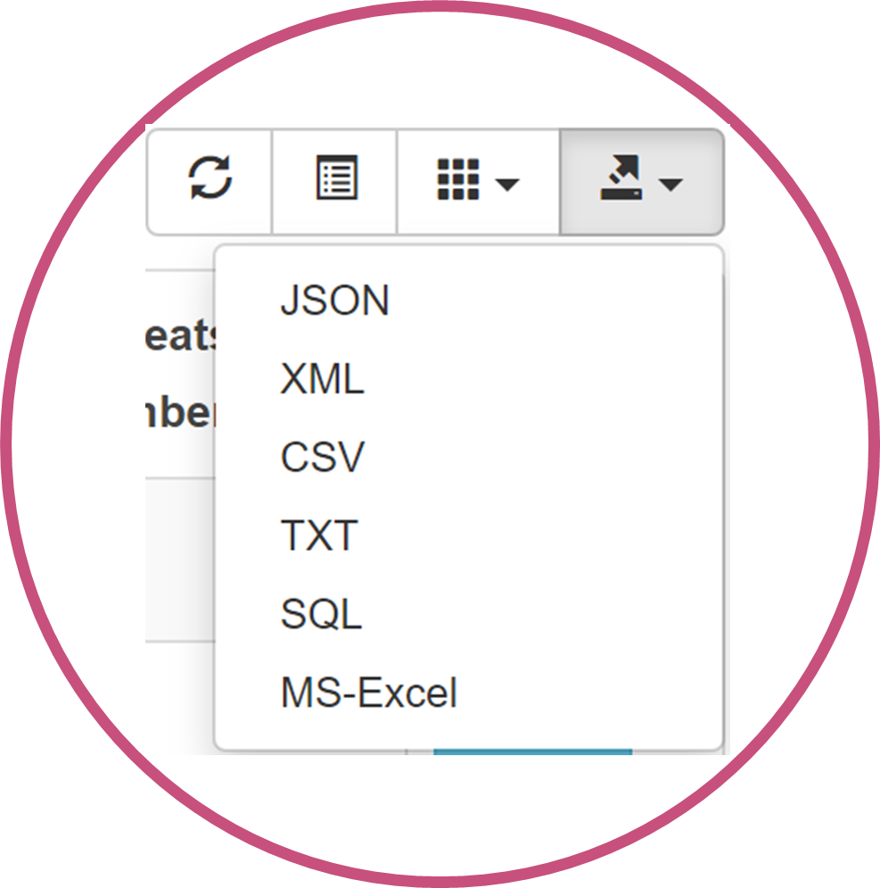
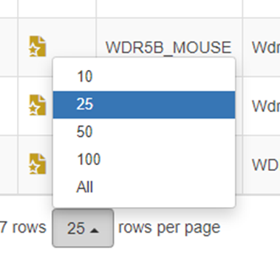
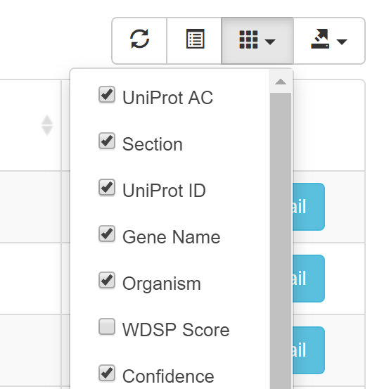
Search result
Change the display style
Export the search result with basic default columns or selected columns
Select the export file format
Select the columns of the display
Change the number of entries per page displayed

