Slide 1
Protein detail page
WDSPdb 3.0 http://www.wdspdb.com/wdspdb3/

Slide 2
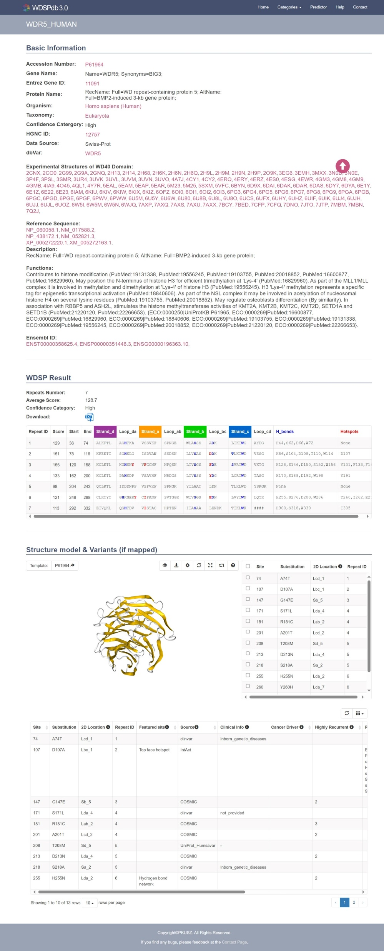
Protein detail page: Overview
UniProt ID of the protein
Basic information of the protein
WDSP result
Structural model & checkbox of variants
Variant details table

Slide 3
Protein detail page: Basic protein information
UniProt ID
The PDB structures covering the WD40 repeats
Red text: external links leading to related resources
Jump to the top of this page

Slide 4
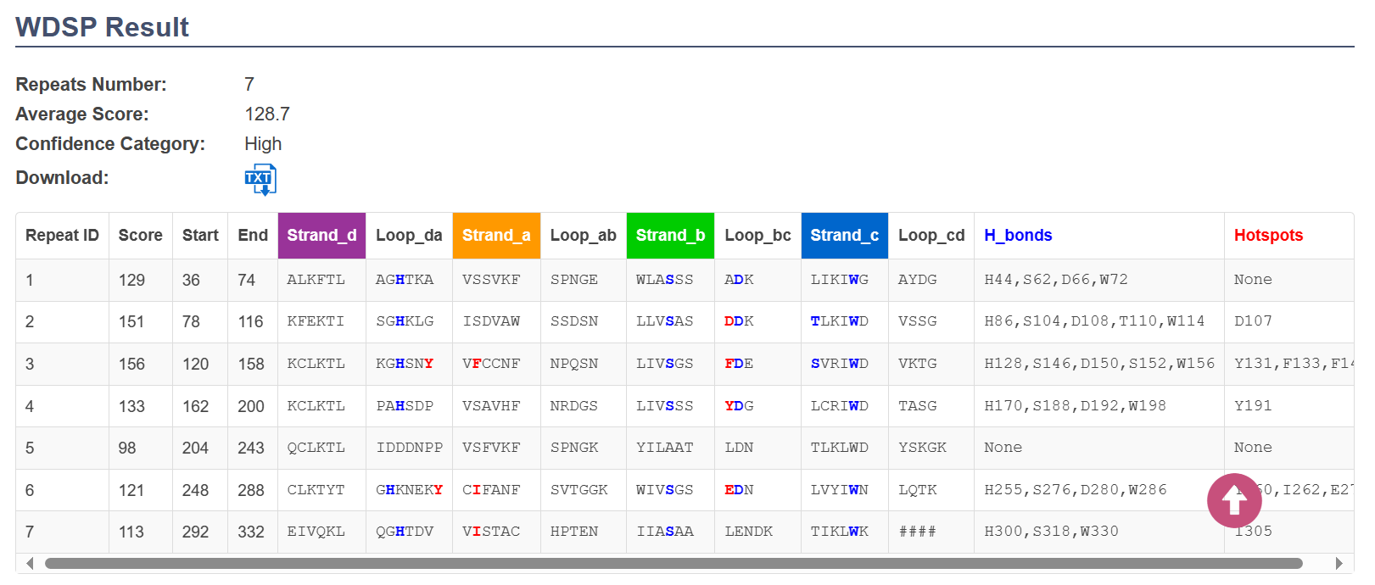
Protein detail page: WDSP result
The number of predicted WD40 repeats
Confidence category: “High”, “Middle” or “Low”
Download the plain text of WDSP result
WDSP result
Hotspot residues on the top face
The red letters represent the potential hotspot residues on the top face
The blue letters represent the residues involved in forming the hydrogen bond network
The residues of hydrogen bond networks

Slide 5
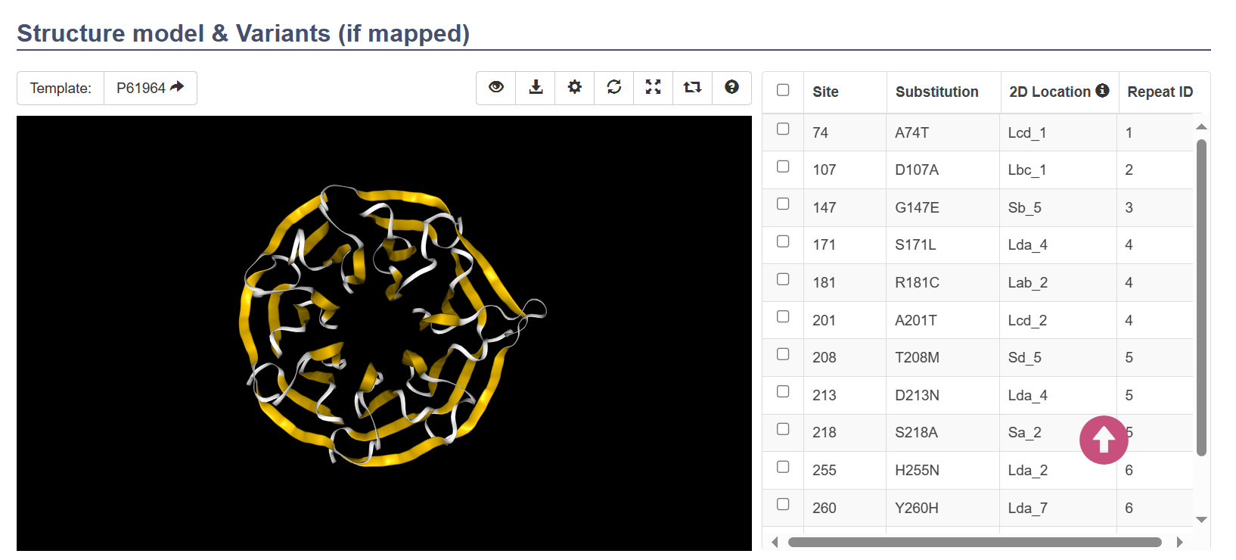
Protein detail page: Structure model & checkbox of variants
Structure viewer action bar
The checkbox of variants which can control their display on structure model
The model template link (may be itself)
Structure model viewer

Slide 6
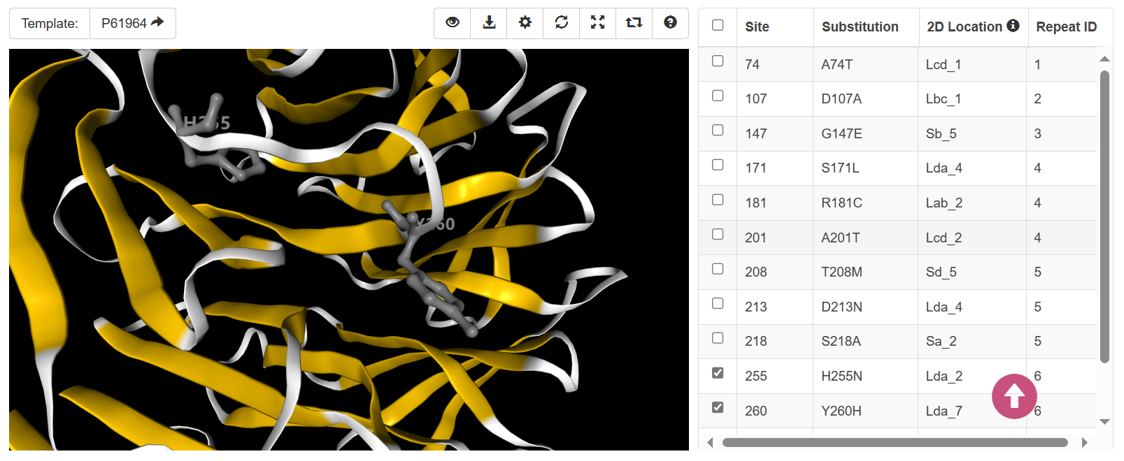
Protein detail page: Structure model & checkbox of variants
Display residues of the selected variation sites on the structure model
2. Stick display residues of the selected variation sites on structure model
The button to the help page
1. Select the interested variants

Slide 7
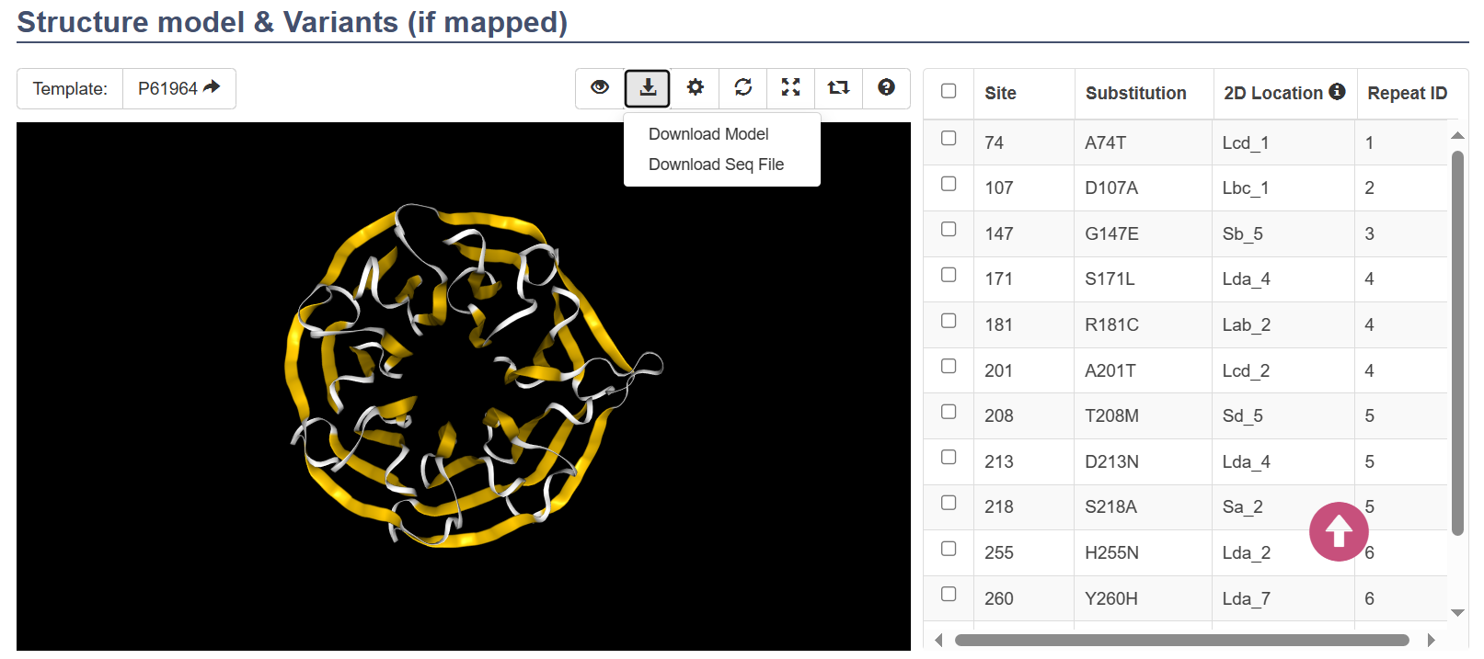
Protein detail page: Structure model & checkbox of variants
Download the structure model or its sequence of the structure model
Download structure or sequence using the drop-down list

Slide 8
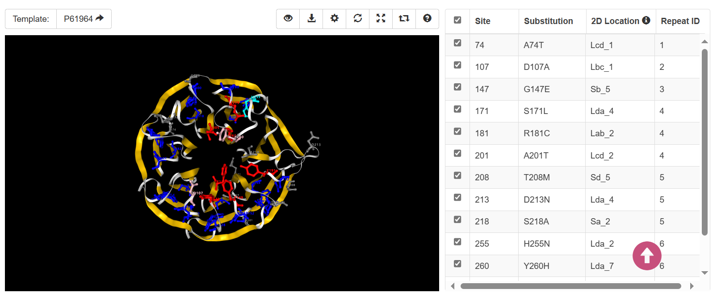
Protein detail page: Structure model & checkbox of variants
Display the sites involved in hydrogen bond networks, potential hotspots on the top face, or variants on the structure model
When turn on the display of the hydrogen bond networks or hotspots, if variants sites superimposed with them, the residue color would change
Display the featured sites using the drop-down list
Red: hotspots on the top face
Cyan: variants on hydrogen bond networks
Pink: variants on hotspots
Grey: variants
Blue: hydrogen bond networks

Slide 9
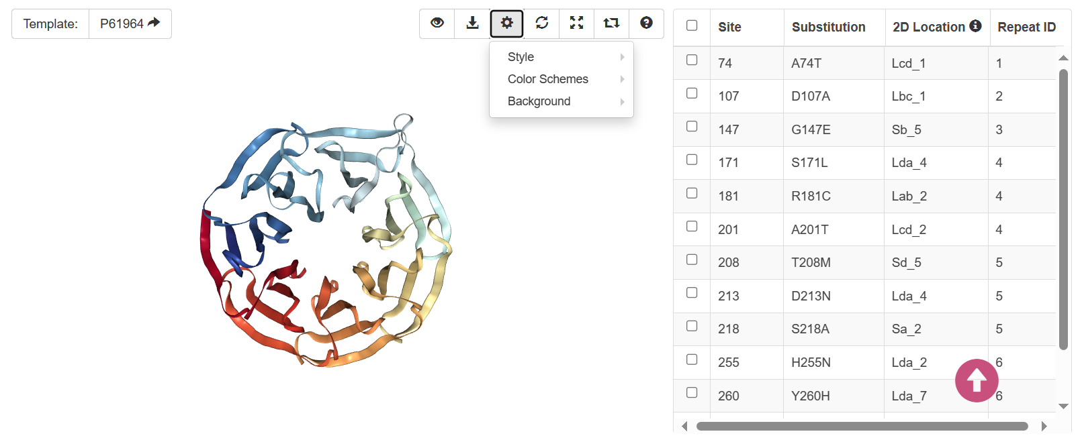
Protein detail page: Structure model & checkbox of variants
Change the display styles, color schemes or background colors using the action bar

Slide 10
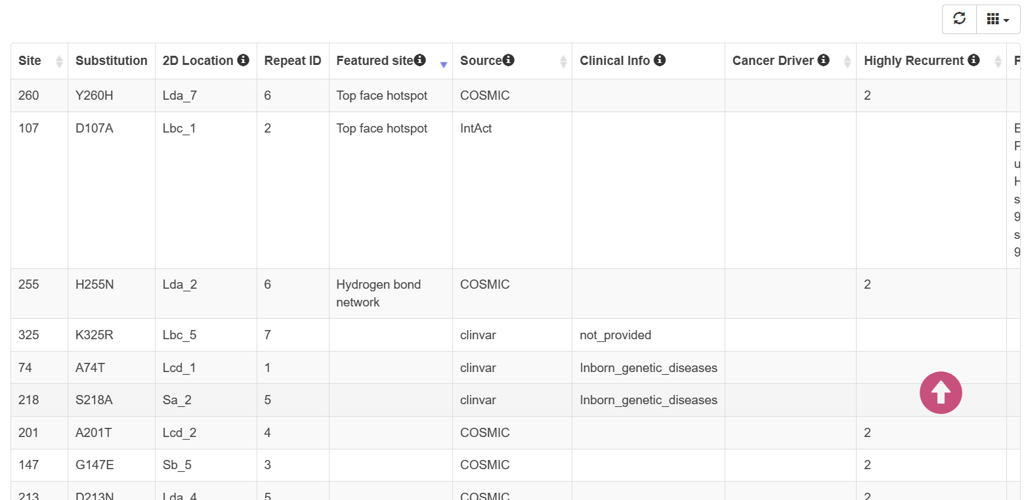
Protein detail page: Variants information table
Whether the variant is highly recurrent in cancer, as annotated in CancerHotSpots and recurrent in COSMIC
The detailed information of the variants
Variants on the site of top hotspots or hydrogen bond networks
Source database
The cancer types driven by this variant, as annotated in IntOGen
The variant effect on the interaction and specific partner, as annotated in IntAct
Clinical information if the variant from ClinVar, Humsavar, Cosmic
Customized display of the columns variants information

