Slide 1
Home page overview
WDSPdb http://www.wdspdb.com/wdsp/

Slide 2
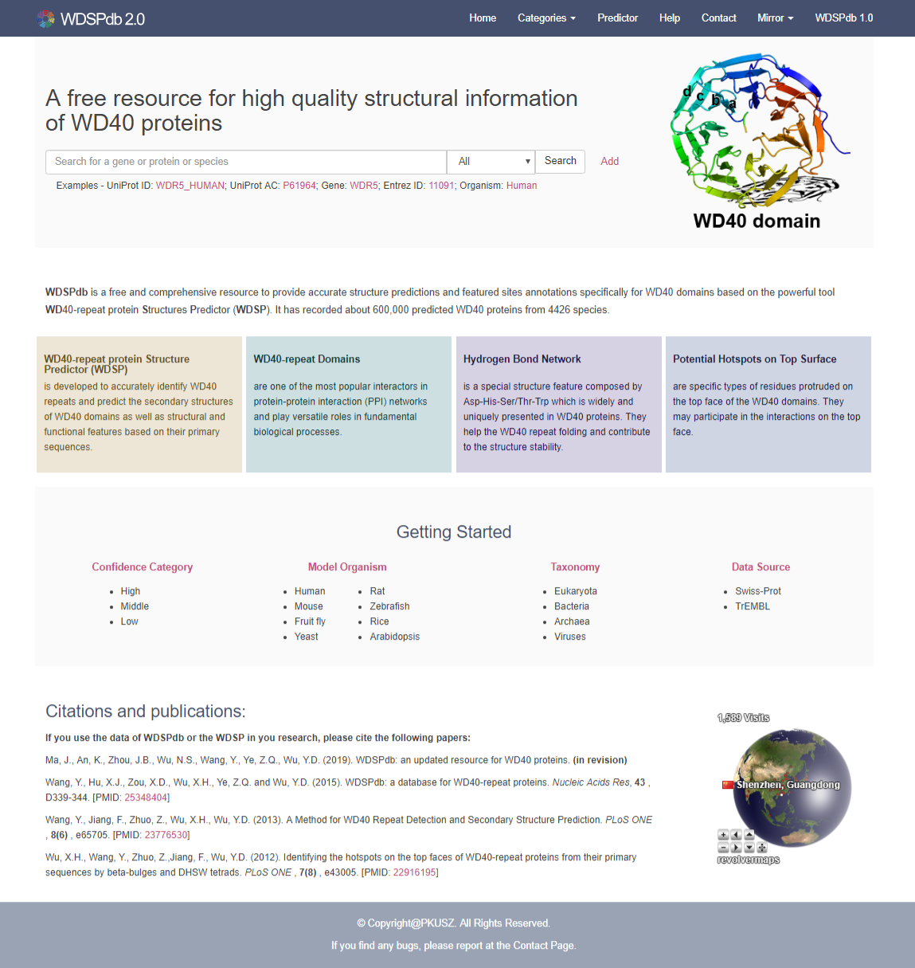
Home page overview
Navigation bar
Search box
At a glance
Getting started
Citations and publications
Visiting records

Slide 3
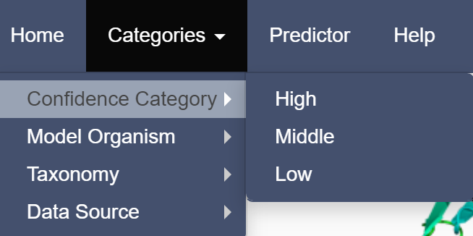
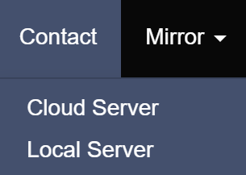
Home page: Navigation bar
Jump to home page
Jump to WDSP predictor
Jump to contact page
Jump to the help page
Jump to WDSPdb1.0
Directed to different categories data
Switch to different mirror

Slide 4
Home page: Search box
Search box
Examples
Specify the type of user's keyword
Add multiple search boxes for advanced searching

Slide 5
Home page: A glance of associated knowledge

Slide 6
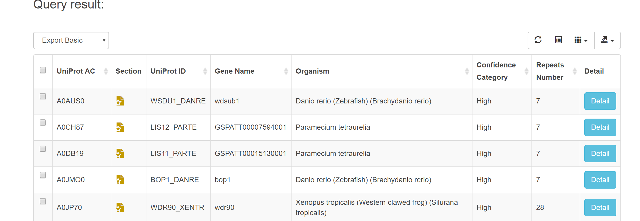
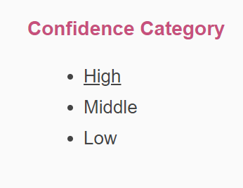
Home page: Getting started
Users can browse the protein list of different categories from the “Getting Started” portal
For example:
Jump to the protein list with “High” confidence category

Slide 7
Home page: Citations and publications
WDSPdb 2.0
WDSPdb 1.0
WDSP predictor algorithm
Interaction hotspots prediction

Slide 8
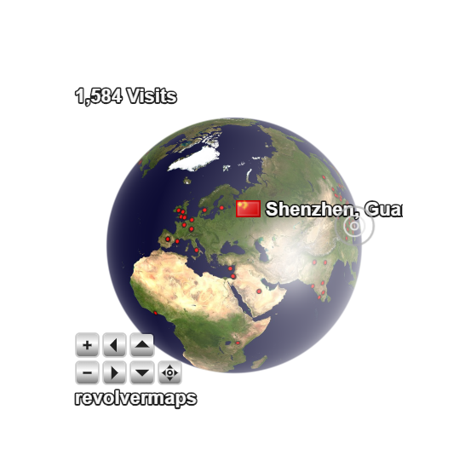
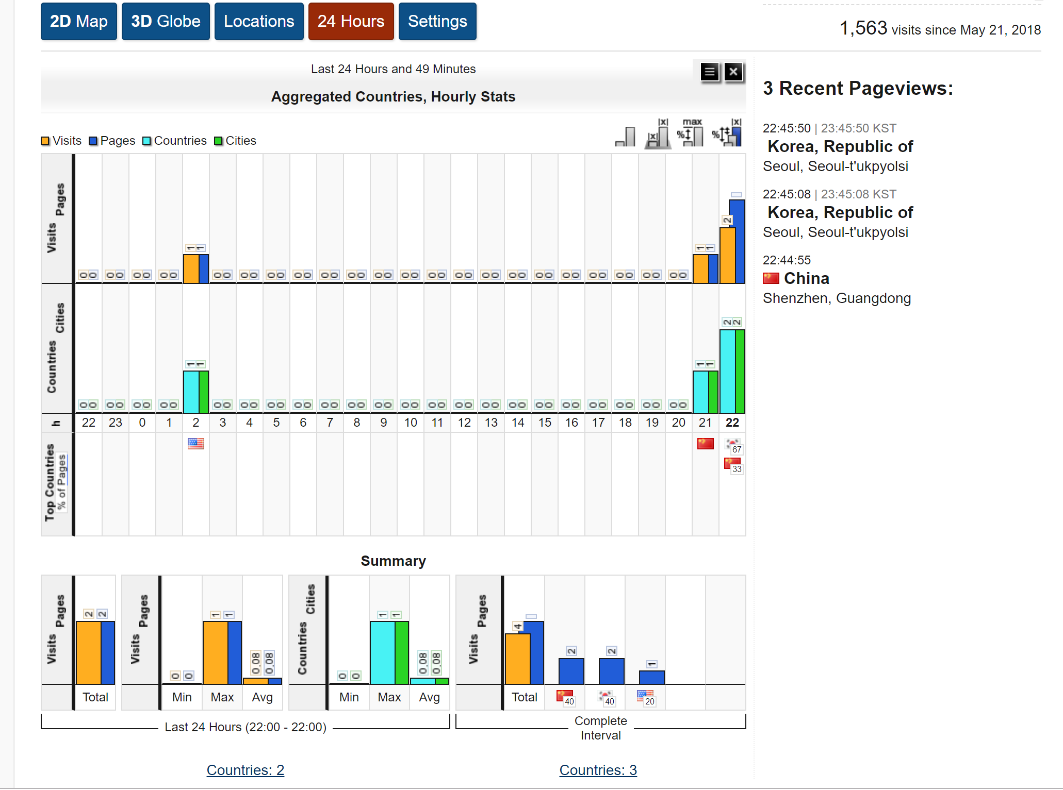
Home page: Visiting records
The details of the visiting records
Tellurion action bar

