Slide 1
How to use WDSP predictor?
WDSPdb http://www.wdspdb.com/wdsp/

Slide 2
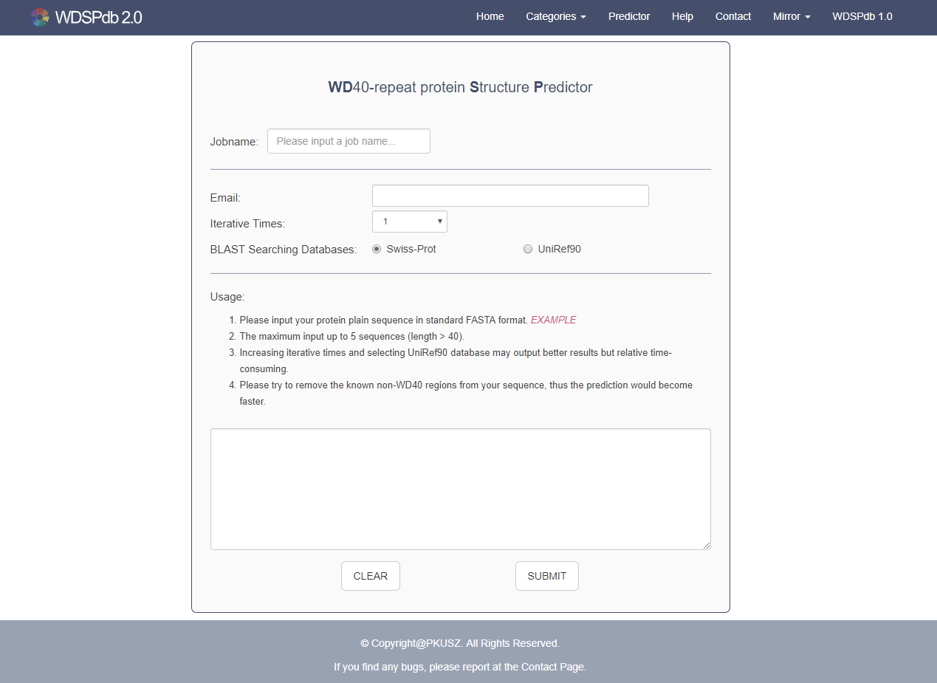
The WDSP predictor
The job name
Entrance of WDSP predictor in navigation bar
Email address to receive prediction result
Iterative rounds for running the predictor
Usage of the WDSP predictor
BLAST searching database
Inputting sequences for predicting
Submit button

Slide 3
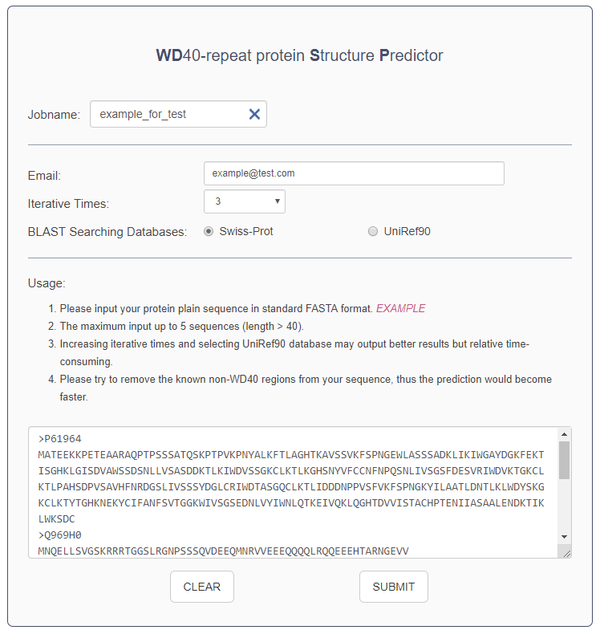
The pipeline of using WDSP predictor
Input the job name. The name should be composed by character, digit, underline, vertical bar, dot, and square brackets and its length<=20.
Leave an email address for receiving the prediction results. The server will check if you have entered a valid address.
Choose the iterative rounds of WDSP running for each sequence. And the predictor will output the best result.
Select the sequence database for running BLAST
Input the protein sequences in standard FASTA format. The unnatural amino acids are not allowed. The maximum input is 5 sequences and the length must be >= 40 residues.
Click the button “SUBMIT” to submit the job

Slide 4
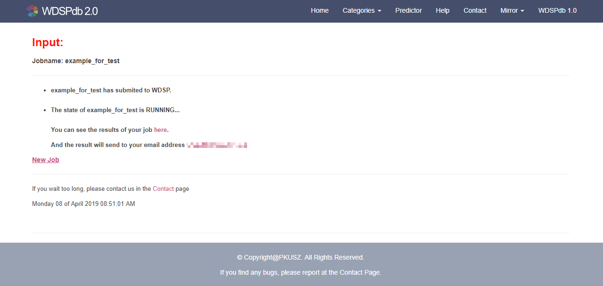
The link to the job result
After the job submitted, the predictor will jump to the page including the result information
The job name submitted
The link to the result page
example@test.com
The email address for receiving to the link of prediction result

Slide 5
The link to the job result
The WDSP predictor will take some time to run the job
Before the job complete, the result page will show as following

Slide 6
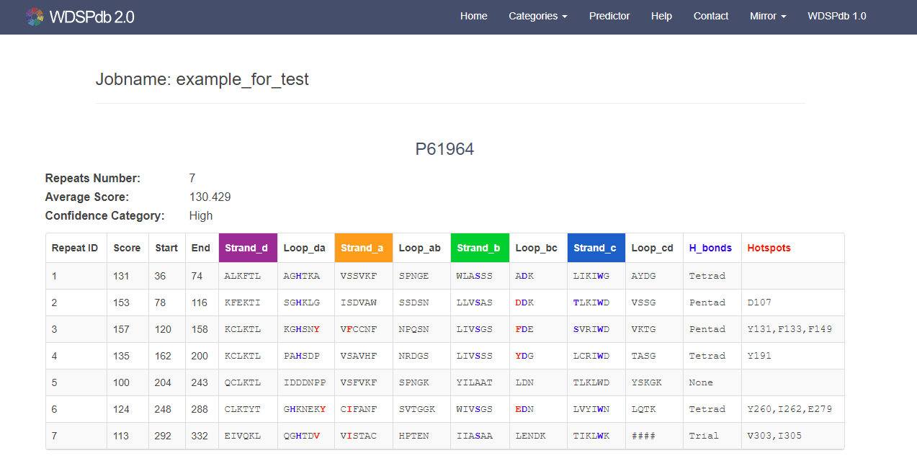
The predicted result
When the job is complete, the result page will present as following
The job name submitted
The sequence identifier
WDSP prediction result
Note: The interpretation of the prediction result refers to the guide of “Protein detail page” and the Help page.

Slide 7
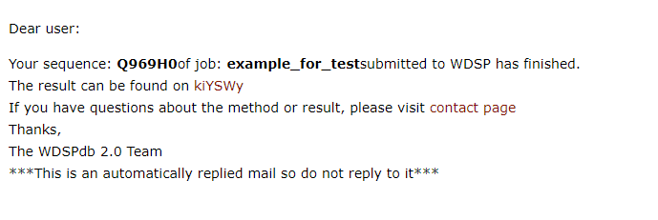
The email from WDSP predictor
When your task is complete, the WDSP predictor also send an email to the address you inputted
The contents of the email are as follows
The sequence identifier
The job name submitted
The link to result page.
> “kiYSWy” is the unique ID generated by WDSP predictor for each job.
The result link composed as follow: http://www.wdspdb.com/wdsp/output/kiYSWy
Note:
If the job contains more than one sequence, the WDSP predictor will send an email after each sequence prediction is completed.
No matter how many sequences in the job, they will present in the same result page.

